Slide 1

GROUP 6
Members:
1.Nurul Syahida binti Roslan
2.Khairul Irfan bin Basir
3. Nur Fatini binti Abdullah
4. Nur Athirah binti Zulkafli

Slide 2
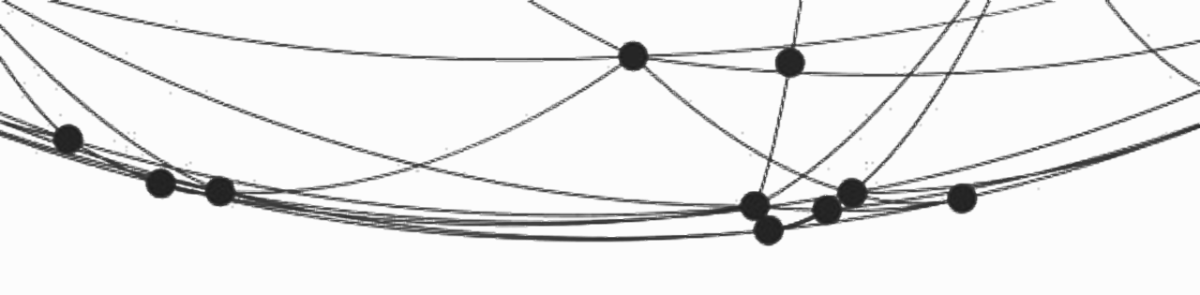
Aim
To design a predictive model to determine the potential customers

Slide 3





Presentation Timeline
Exploratory Data Analysis
Features Engineering
Data
Pre-processing
Machine Learning Model
Conclusion & Recommendation

Slide 4
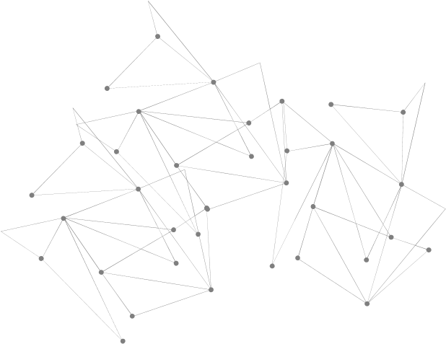
Introduction
Data Characteristics
The raw data contain (4469 rows , 25 columns)
The data contain mixture of continuous and discrete data.
Data cleaning
Removing duplicates data
Replacing the (‘$’ and ‘,’) sign
Removing unnecessary column (C_ID,Cust_Last_Purchase)
The null value is being filled by the median
After the cleaning, the data is left with
(3618 rows , 23 columns)

Slide 5
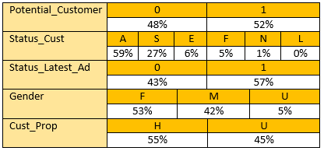
Exploratory Data Analysis
Categorical Data:
# most of the people in the dataset is an active buyer
# There are 10% more female in the dataset and around
Notes:
Numerical data banyak sangat so tak payah tunjuk pun okay rasanya. Just cakap other than shown here, is numerical data.
# most of the people in the dataset is an active buyer
# There are 10% more female in the dataset and around

Slide 6
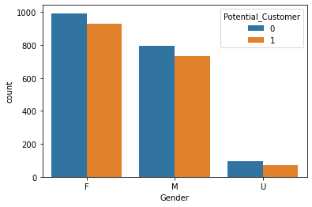
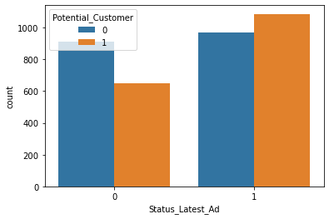
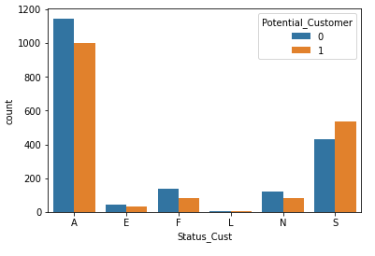
Relationship Between Categorical & Target Variable
Female customer is more likely to become a potential customer.
Customer that purchase in response to the recent ads are likely to become a potential customer.
Active customer are likely to become a potential customer.
Notes:
Graph 1: Female has high tendency to spent compare to male. Female also higher tendency to become potential customer
Graph 2: individual made purchase in response to last promotional sale tend to become potential customer. Individual who did not response to last promotional sale tend to not become potential customer

Slide 7
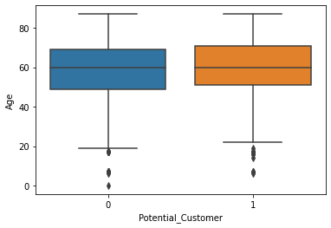
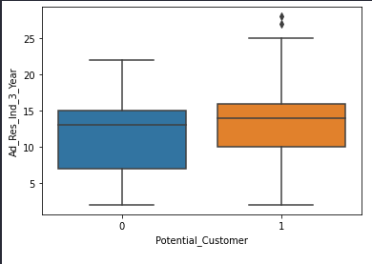
Relationship Between Numerical & Target Variable
Mean of both potential and not potential buyer is around 60 years old
Individual who responded to ad (affliate) in last 3 years that become potential customer has less IQR value.
Notes:
# Mean of both potential and not potential buyer is around 60 years old
# The trend of ‘inactive no of month since customer made the last purchase’ has many outlier regardless they are potential customer or not
# At first glance, we can not see any significance correlation between the numerical features and target variable

Slide 8
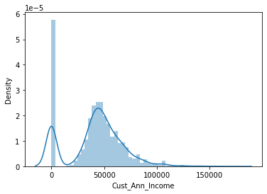
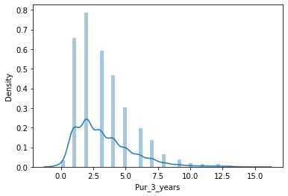
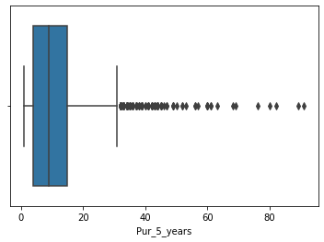
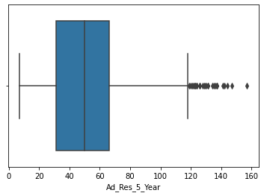
Exploratory Data Analysis
NaN value Median
Notes:
Aku pilih boxplot yang skewed to show median is a better option
#Most of data is highly skewed. Thus we decided to replace the NaN values with median of each respective feature.

Slide 9
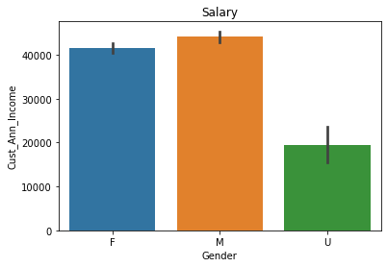
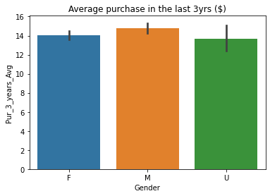
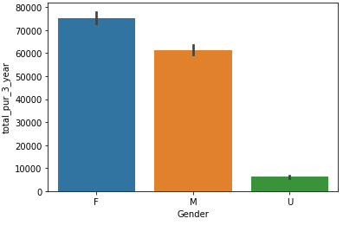
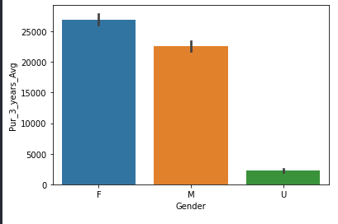
Exploratory Data Analysis
Total Purchased In Last 3 year
Notes:
3.5: Graph 1 and 4 : Male earn more than Female,Female spent more than Male in the last 3 years.
Graph 2 and 3: Male spent more money than female, but female has higher number of purchase than Male
# Female has high tendency to spent compare to male. Female also higher tendency to become potential customer
# individual made purchase in response to last promotional sale tend to become potential customer. Individual who did not response to last promotional sale tend to not become potential customer
# Active buyer is very highly likely to become potential buyer compare to others

Slide 10
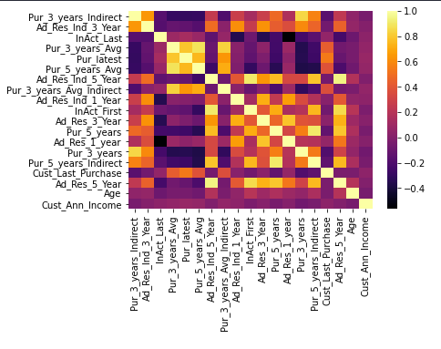
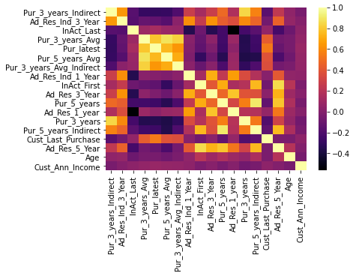
Numerical Data Correlation
Original Features
Reduce Features
Score_train = 0.58
Score_test = 0.56
Score_train = 0.57
Score_test = 0.56

Slide 11
Features Engineering
New Features | Derived From
total_pur_3_year(Total amount of purchases in 3 year) | Pur_3_years(Number of purchase in 3 year) Pur_3_years_Avg(Average amount of purchase in 3 year)
total_pur_5_year(Total amount of purchases in 5 year) | Pur_5_years(Number of purchase in 5 year) Pur_5_years_Avg(Average amount of purchase in 5 year)
Pur_3_years_Direct(Number of purchases made in 3 years from direct buyer) | Pur_3_years(Number of purchase in 3 year) Pur_3_years_Indirect(Number of purchases made in 3 years from indirect buyer)
Pur_5_years_Direct(Number of purchases made in 3 years from direct buyer) | Pur_5_years(Number of purchase in 5 year) Pur_5_years_Indirect(Number of purchases made in 3 years from indirect buyer)

Slide 12
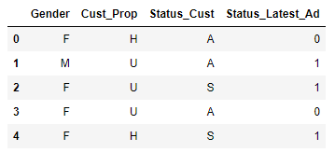
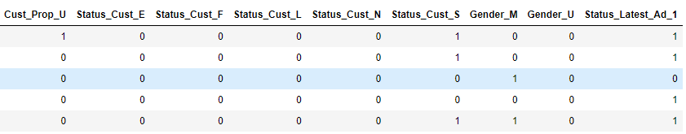
Data Pre-processing
Create a dummy variable
Change Categorical Variable into Numerical Variable

Slide 13
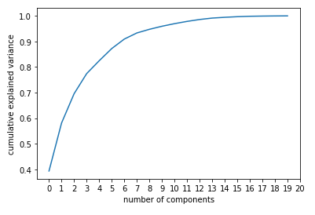
Data Pre-processing
Feature Scaling
PowerTransform
PCA analysis
n_component : 8

Slide 14
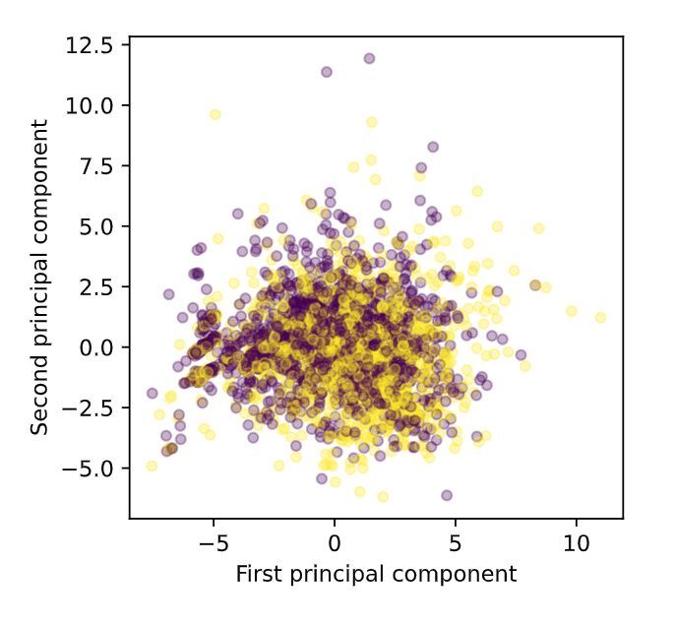
Visualize Data after PCA(n_component)
The data shown here are 60% of the total data.
Observe that the data are not linear
The target variable are overlapping with each other which will affect the algorithm result.

Slide 15
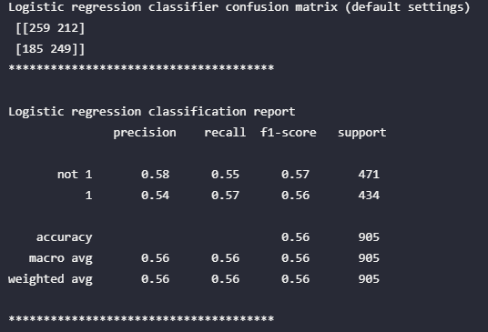
Machine Learning Model
LOGISTIC REGRESSION
Insight :
Accuracy on train set = 0.57
Accuracy on test set = 0.56
LR best score= 0.58
Parameter:
'C': 0.001, 'fit_intercept': True, 'penalty': 'l2', 'solver': 'lbfgs'
ridge regression(penalty:L2)

Slide 16
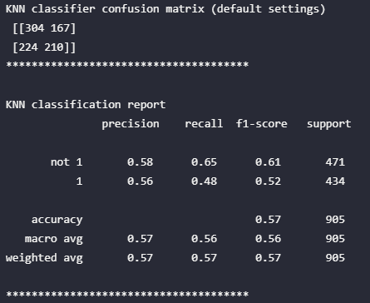
Machine Learning Model
KNN CLASSIFIER
Insight :
Accuracy on train set =0.62
Accuracy on test data =0.57
KNN best score= 0.57
Parameter:
'n_neighbors': 19, 'p': 2
euclidean distance(p=2)

Slide 17
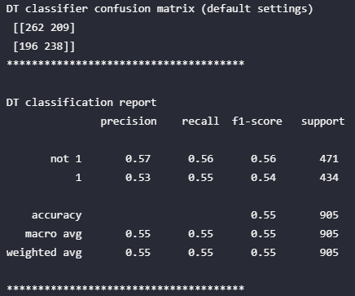
Machine Learning Model
DECISION TREE
Insight :
Accuracy of max_depth=4 on train set = 0.59
Accuracy max_depth=4 on test set = 0.55
Decision tree best score=0.56
Parameter:
'max_depth': 4

Slide 18
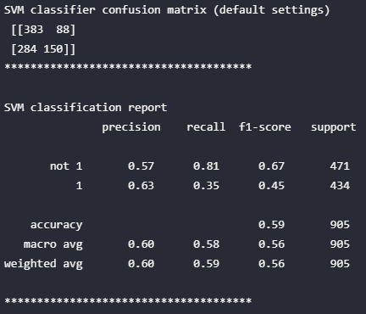
Machine Learning Model
SUPPORT VECTOR MACHINE(SVM)
Insight :
Accuracy on train set = 0.62
Accuracy on test set = 0.59
SVM best score=0.60
Parameter:
'C': 0.16681005372000587, 'gamma': 0.1, 'kernel': 'rbf'

Slide 19

Conclusion & Recommendation
The best model that we choose is SVM because it yields the best score for the test set compared to the rest of the model.
Recommendation
Process the outliers (Replacing or removing it)
Use deep learning to train the model.
Remove the data with high correlation.

Slide 20

Thank you

